Slide 1
The M-Factor
Round 2: Case Study
Candidate name: Lê Quang Đoàn

Slide 2
Part 1
Answers and Dashboard

Slide 3
Part 1
616
616
Part 1.1
Total Revenue in January : ………1410427.02 …………….
Data : https://github.com/connanvn9/MoMo_Talent_2021
File : momopart1.xlsx
Part 1.2
Total New Users in January : ……………616……….
Data : https://github.com/connanvn9/MoMo_Talent_2021

Slide 4
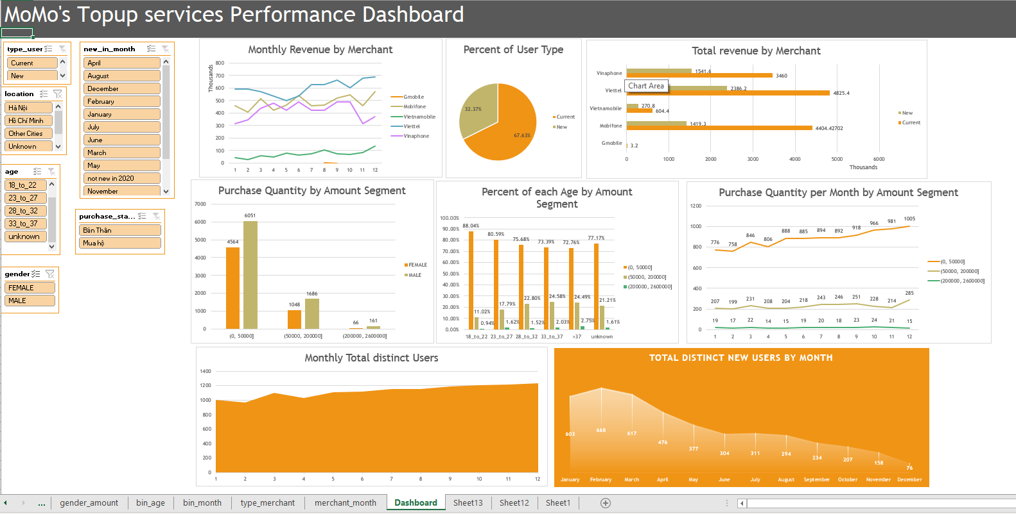
Part 1
[Put your performance dashboard below]
[Charts here]
Data : https://github.com/connanvn9/MoMo_Talent_2021
File : momopart1.xlsx

Slide 5
Part 2
Findings and Advices
Note: I kindly suggest that you should use the dashboard in excel for more convenient.
Data : https://github.com/connanvn9/MoMo_Talent_2021
File : momopart1.xlsx

Slide 6
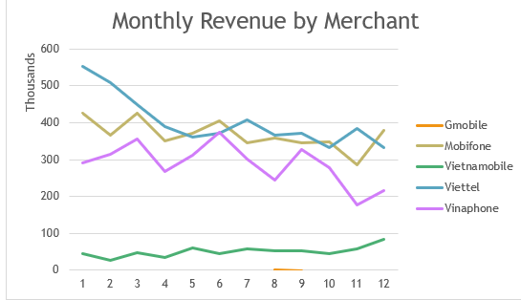
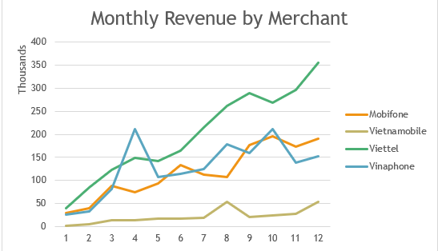
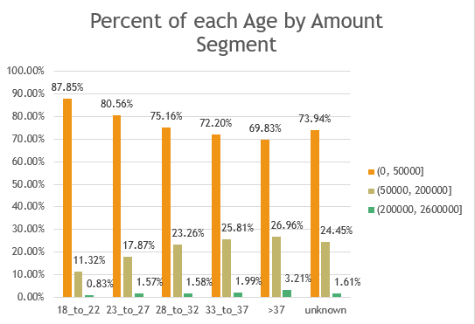
Part 2.1
New/Current
In general, revenue increased from both. Although current users brought the highest Mobiphone revenue which surpassed Viettel, It was decreasing in total.
- In contrast, New users showed their potential.
Mua hộ
- “Mua hộ” became a strong trend despite the small number.
Older Customers tended to buy at higher price per order.
Purchase Quantity from Male was sharply increasing.

Slide 7
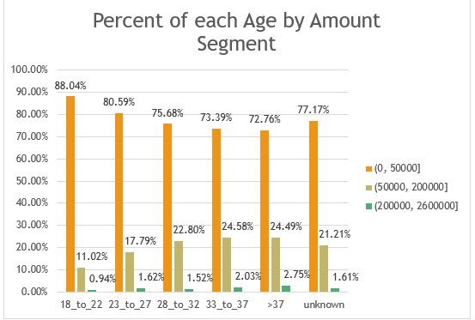
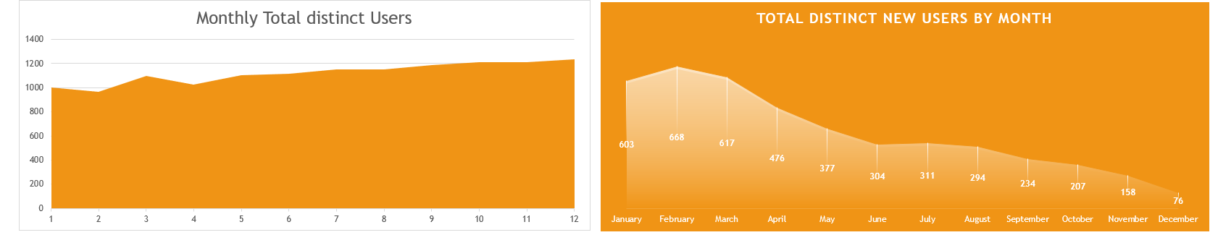
Part 2.1
Amount: total amount of money that user spend (VND)
- The same with ‘Mua hộ’, Older Customers tended to buy at higher price per order.
New in month: Monthly, Users who made first transaction in 2020.
The growth was slow down but there was still increasing of Total distinct user.
=> Service was still holding customers but attracting less New in month Users.

Slide 8
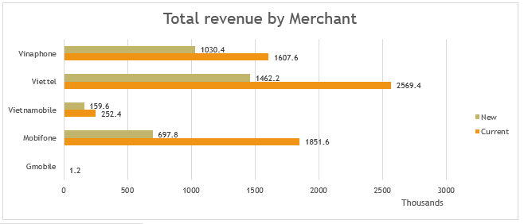
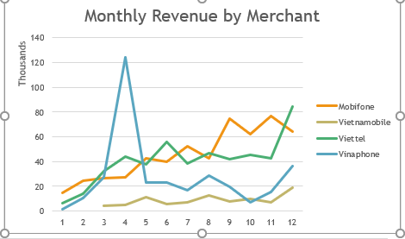
Part 2.1
My advice: MoMo should focus on customers who are:
28 years old and above
Not making any transaction.
Making strategy with Location concern.
Enhancing connection between Users because of “Mua Hộ” incresing
Location
Users from Other Cities were the service’s main because of highest revenue from them.
Users who lived in Ha Noi liked Viettel, but Ho Chi Minh City ‘s users was attracted to Mobiphone.
However, in 2020, new users who were from Ho Chi Minh City tended to replace Mobiphone by Viettel

Slide 9
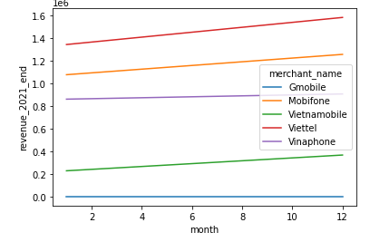
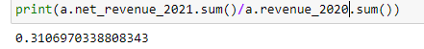
Part 2.2
According to 2020, I predict the revenue scenario in 2021 with new promotion campaign from MoMo marketing department.
Method:
- Using least squares regression.
Doubling the monthly amount due to the campaign.
Result: At the end of 2021, Revenue would be decreased by 69% even though I doubled the monthly revenue.

Slide 10
Part 2.2
Customer perspective: It would be very attractive campaign. Using this service immediately.
Sale and Marketing: Looking at this as a huge potential campaign. Optimistic with the sale scenario and the Market Growth. More competitive to opponents.
Shareholder: It could be superb awful. With this promotion, The Net Revenue would dramatically decrease. However, They still have hope for better future because of the market domination.
Economist: Not thing could be worse. The product value is standing still but the price becomes cheaper which could lead to devaluation in future due to more aggressive competitive opponents.
My advice:
Instead of cashback, contacting the merchants to increase the product value. Because the merchants know that MoMo is a top sale channel.
For instance, increase 5% the value of order or additional data usage. As a customer, I would love to take 5% higher value than 4% cashback.

Slide 11
Part 3
Idea and Creativity

Slide 12
Part 3.1
Motivation
The service was not attractive to new customer as I show you in Part1.
“Mua Hộ” seemed to be on trending.
The opponents tended to be more aggressive.
II. Benefit From “Liên kết càng mạnh, quà càng giá trị”.
To get more promotion, users themselves would have to invite more new customers to join the campaign which solves the attraction problem.
“Mua Hộ” is on the way taking off, the campaign would give it a shot to get to the peek.
The links of people in modern world is superb. One connection leads to another. Customer would be more aggressive than our components.

Slide 13
Part 3.2
The size of largest relationship circles : ……14 people……………….
The number of largest relationship circles : ………………1…….
Algorithm Explanation : [Google Sheet/ Google Colab Link (if any)]
Data : https://github.com/connanvn9/MoMo_Talent_2021
File : Momo challenge.ipynb

